Slide 1

The Problem of Data Augmentation
What to Synthesis?
Price Time Series
Price -> POD
Price -> Orderbook
Price -> events

Slide 2
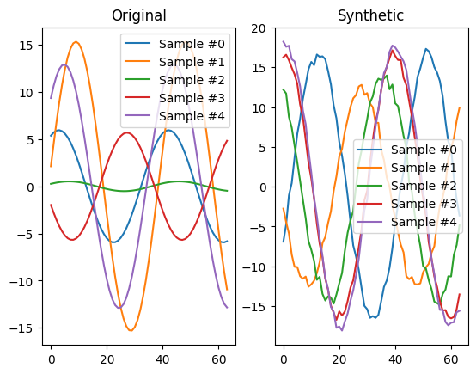
Jittering / Gaussian noise
Jittering / Gaussian noise

Slide 3
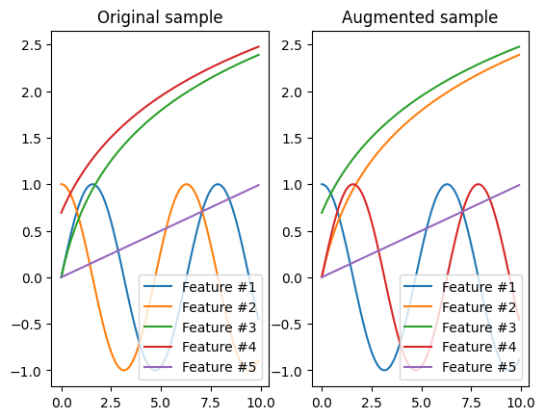
Shuffle Features

Slide 4
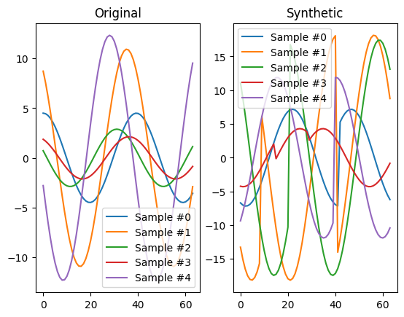
Slice & Shuffle

Slide 5
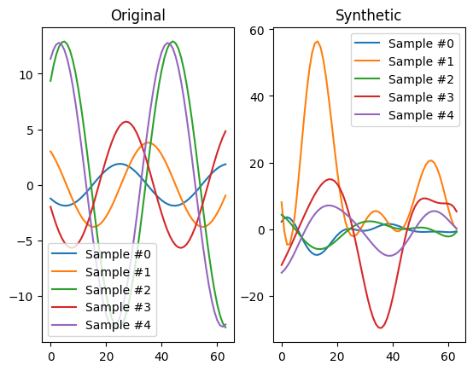
Magnitude Warping

Slide 6
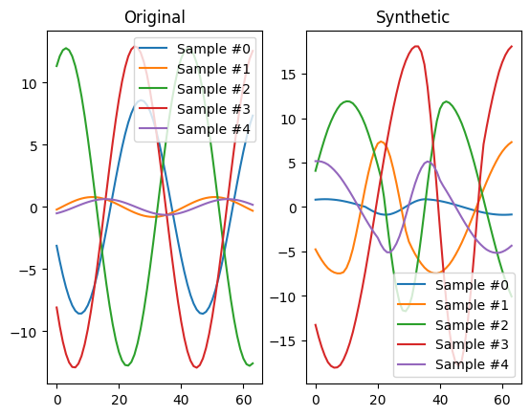
Window Warping

Slide 7
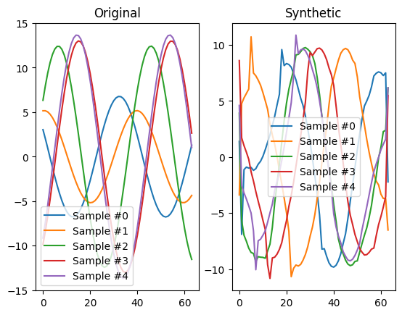
Dynamic Time Warping Barycentric Average (DTWBA)

Slide 8
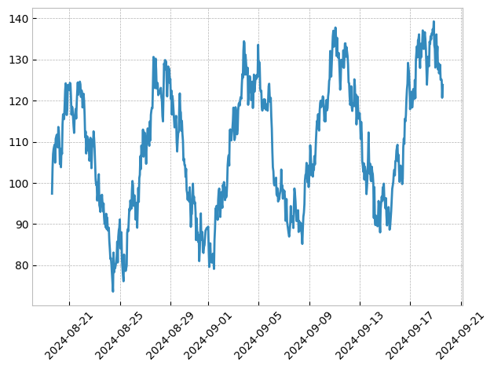
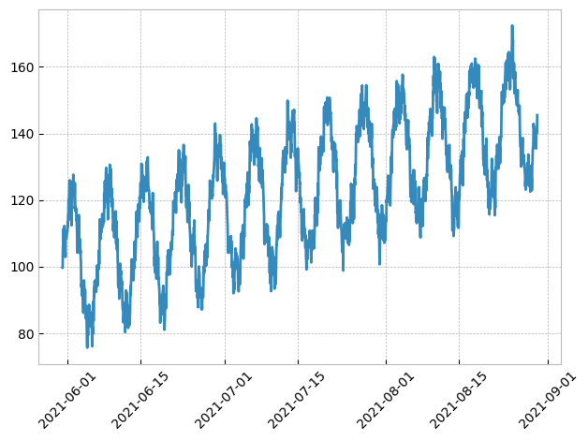
Mockseries
Actual
Generated

Slide 9
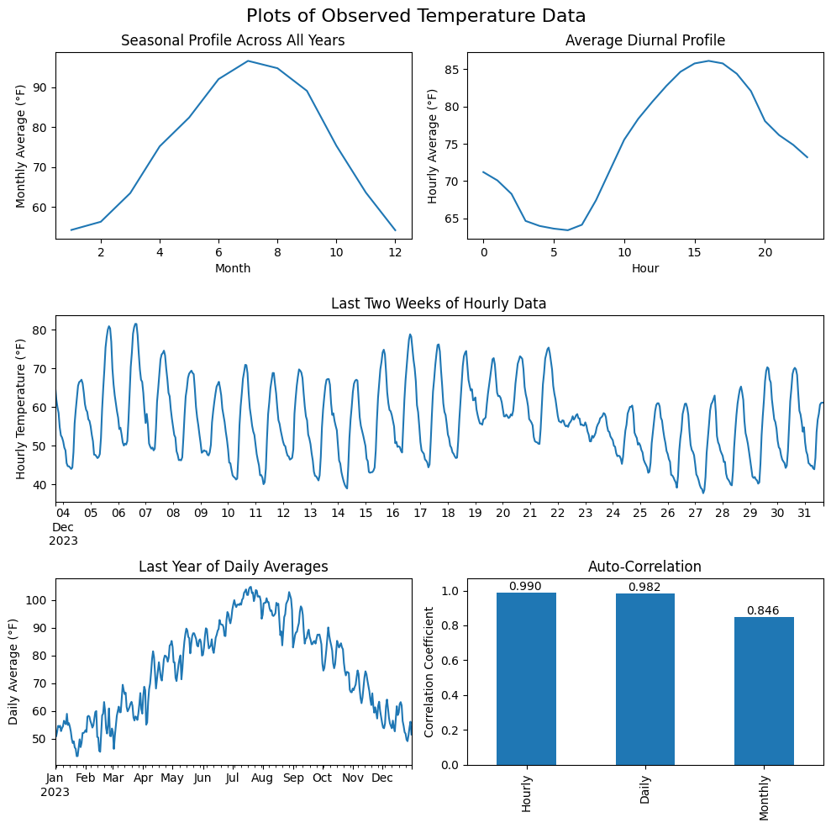
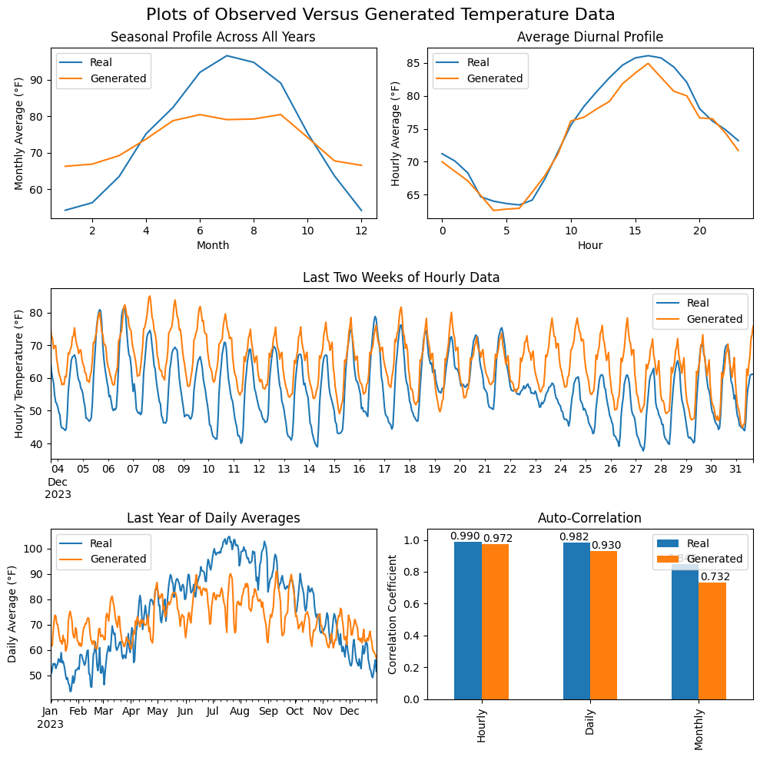
Auto Encoder

Slide 10
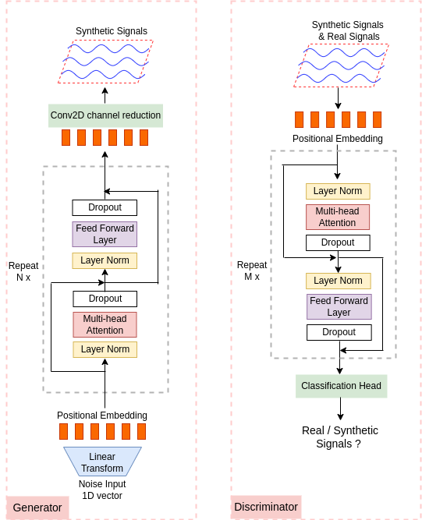

TTS-GAN

Slide 11


Real Running
Syn Running

Slide 12


Real Jumping
Syn Jumping

Slide 13
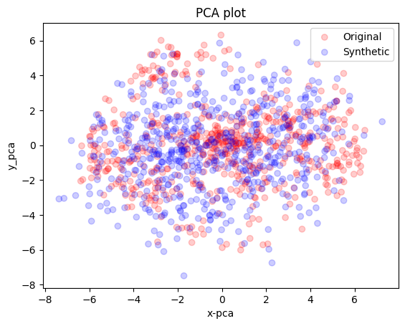
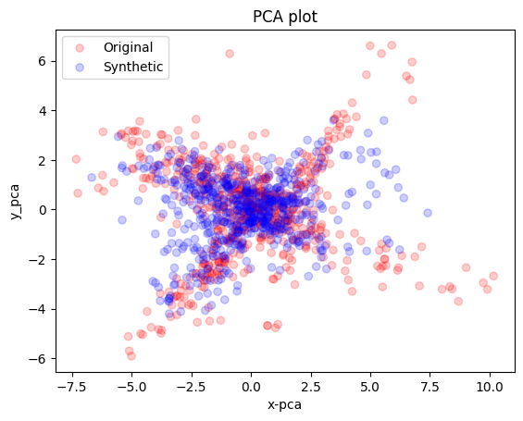
Running
Jumping

Slide 14
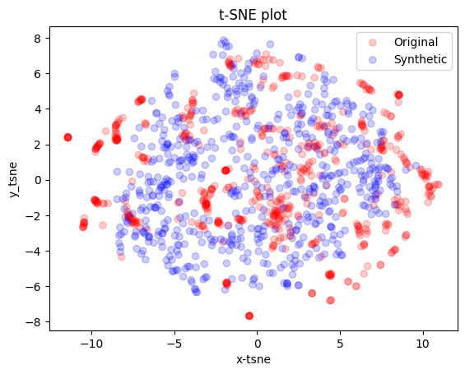
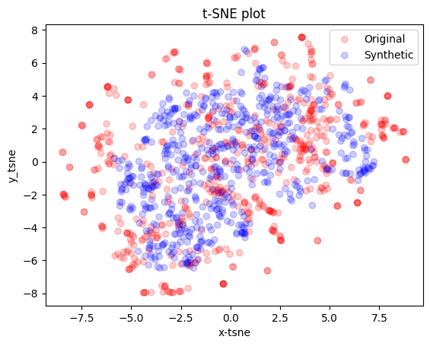
Running
Jumping

